Slide 1
Sprint 4

Slide 2
Challenges We Have Faced
Time Management
Remembering to charge the robot
Traveling to school almost everyday
Only having 2 people in our group when everyone else had 4
Instead of focusing more on the block code we rushed through it
Being able to plan ahead of time and not wait till the last minute
Writing down our steps as we went through testing the robot
Room availability

Slide 3
Roles Each Member Had
Eddie: Manager
Responsibility
Create a flowchart, create a test table, create gantt chart, create system design document, create a robot video, and create blockcode
Joseph: Ceo
Responsibility
Build requirements table, create an algorithm, create a staffing plan, create github repositories, create a sensor data diagram, create gantt chart, and create system design document

Slide 4
What We have Learned From Software Engineering
When working on the Sphero Edu Robot Project, we used a lot of concepts from software engineering into this project. We planned ahead to help keep us on track, but must definitely improve on this. Also when things didn’t go as plan, we used problem solving skills to figure out what was wrong and how to fix them. Trial and error was a big factor in this project. We kept track of any changes we did and how they affected our robot, and see if we need to improve it by a lot or by a little. As well as, having multiple people looking at the documents or codes, just so everyone is on the same page, or maybe someone has a better idea for that section. Using these principles helped us create a more organized and reliable and understandable Sphero Edu Project that others can use to help them.

Slide 5
What We Do Differently
I would say this biggest thing we would do differently is
Time Constraints, Planning Ahead, Write Down What We did
Time Constraints:
We tended to rush through creating the block code which would cause the robot to go off course a little and not be perfect finding the path
Also problems with when to meet up and use the room. Sometimes it would be both of us using it but other times there would be just one of us trying to perfect the robot.
Planning Ahead:
Next time we should think ahead about what coding blocks would work the best and what materials we need for the project
Planning ahead can help us stay organized in what we need to accomplish and what we have done already and not worry about it anymore.
Ask for Feedback:
We could have went to Professor Eckert for any feedback on how our robot is doing or anything like the flowchart and system design document
We could have also contacted fellow classmates on how to improve our robot or our notes that we are taking for the project

Slide 6
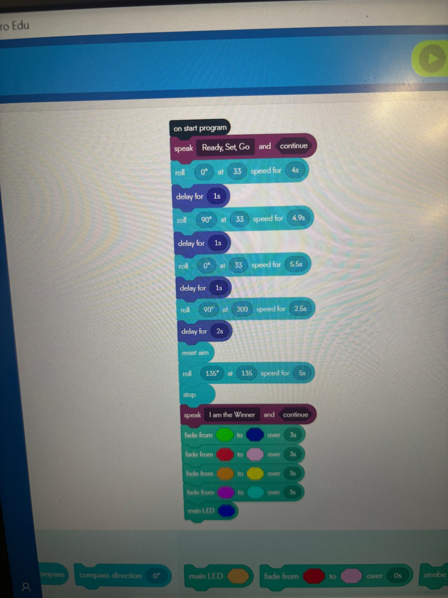
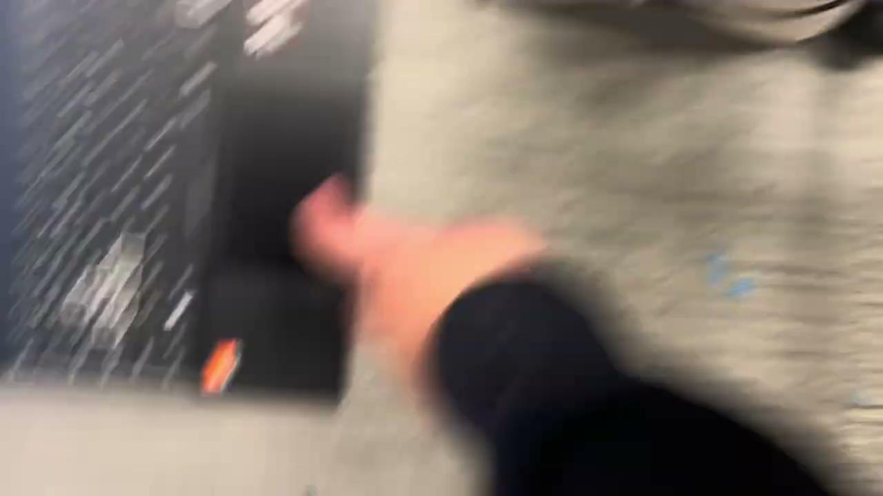
Sprint 3

